Slide 1
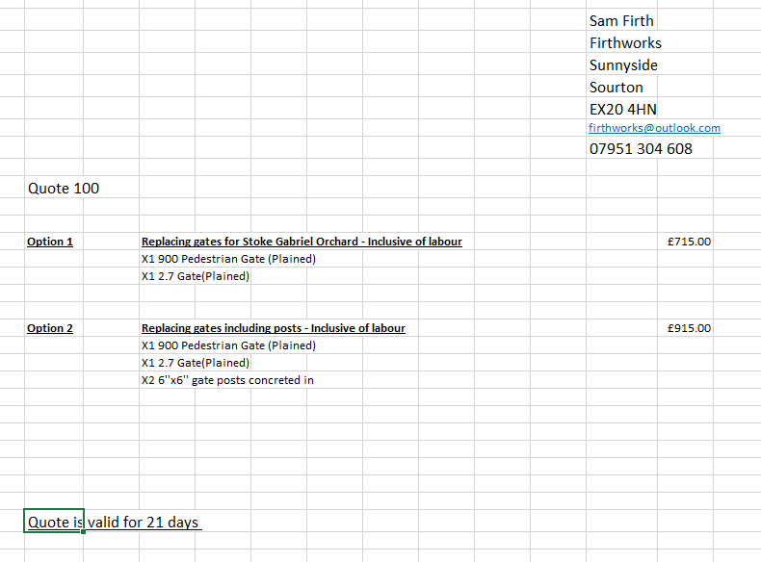
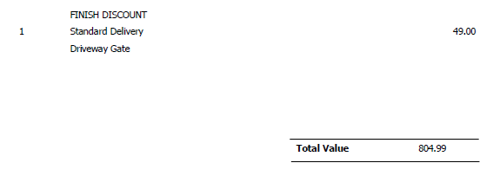
Quotes for gates on Coombe Shute
£20 to remove
£282 fit
£156 big gate
£85 small gate
Total £543
No Fitting supply only!
Including VAT
quote Ex VAT
quote Ex VAT

